Slide 1

Project Title: Movie Ticket Booking System (CINEONE)
FSD PROJECT REVIEW
Presented To:
CAPGEMINI
Team 2:
Karthik Raj S
Vigneshe B
Hariharan Dhanapathy

Slide 2
Problem Statement
The traditional way of going to cinemas can be difficult for customers as customers need to know the availability of seats, show timings, and movie options, especially when there are multiple cinemas in a location.
The present solution for a online booking system might not be sufficient as there needs to be certain more implementations like having age restrictions to watch an A rated movie, and loyalty programs.

Slide 3
Objectives
The previous slide which deals with the problem statement gives way to these objectives which are kept in mind while designing the website:
Implement a fully functioning online movie ticket booking system.
Implement a responsive high level customer or user interface(UI).
Implement a system where the booked/reserved users can download their tickets and present it as a proof of booking.
Implement age restrictions on people going to a movie with A rating through age verification.
Implement a loyalty program scheme for returning users.

Slide 4
Features
Convenience: Online movie ticket booking provides a convenient way for people to buy movie tickets from the comfort of their own homes or on the go, without having to wait in long queues at the box office.
Time-saving: Online ticket booking saves time as customers can book their tickets in advance and avoid the last-minute rush.
Availability: Online movie ticket booking ensures that customers have access to all available seats in the theater, giving them the freedom to choose the best seats as per their preference.

Slide 5
Future Implementations
Future Implementations:
Payment Interface: Payment Interface would be added for booking each movie ticket in their regional currency.
Dynamic Pricing: Implement dynamic pricing strategies based on factors like movie popularity, demand, showtime, or seat location to optimize ticket sales and maximize revenue.
Advanced Booking Options: Providing advanced booking features such as reserved seating for specific user groups (e.g., wheelchair-accessible seats, VIP seats), group bookings, or special event bookings.

Slide 6




Technology Stack
Frontend | Reactjs
Backend | Spring Boot
Database | MySQL
ORM | JPA(Hibernate)
Testing | Junit and Mockito
Code Coverage | Eclemma
Source/Static Code Analyzer | PMD tool

Slide 7
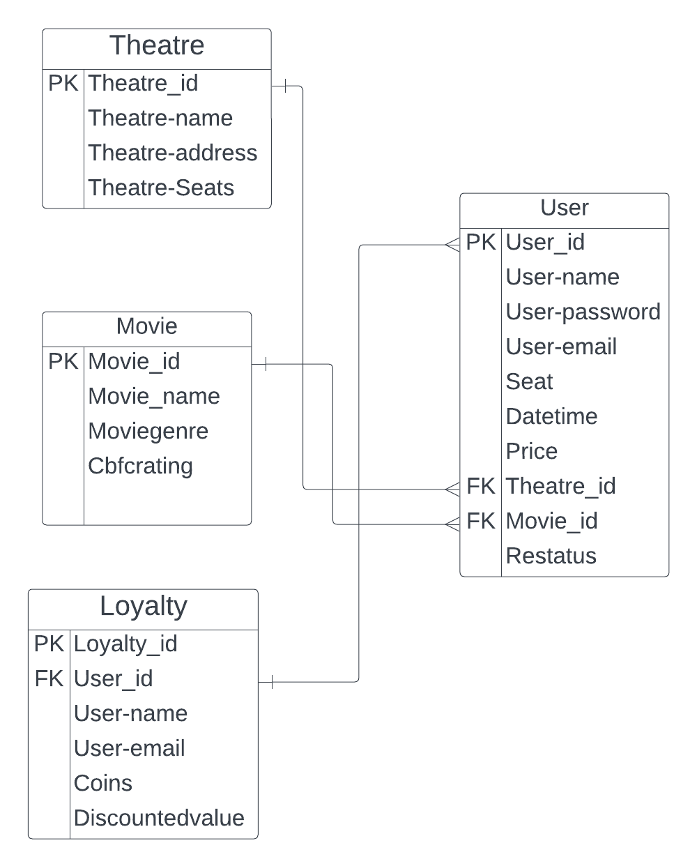
Entity-Relationship Diagram

Slide 8
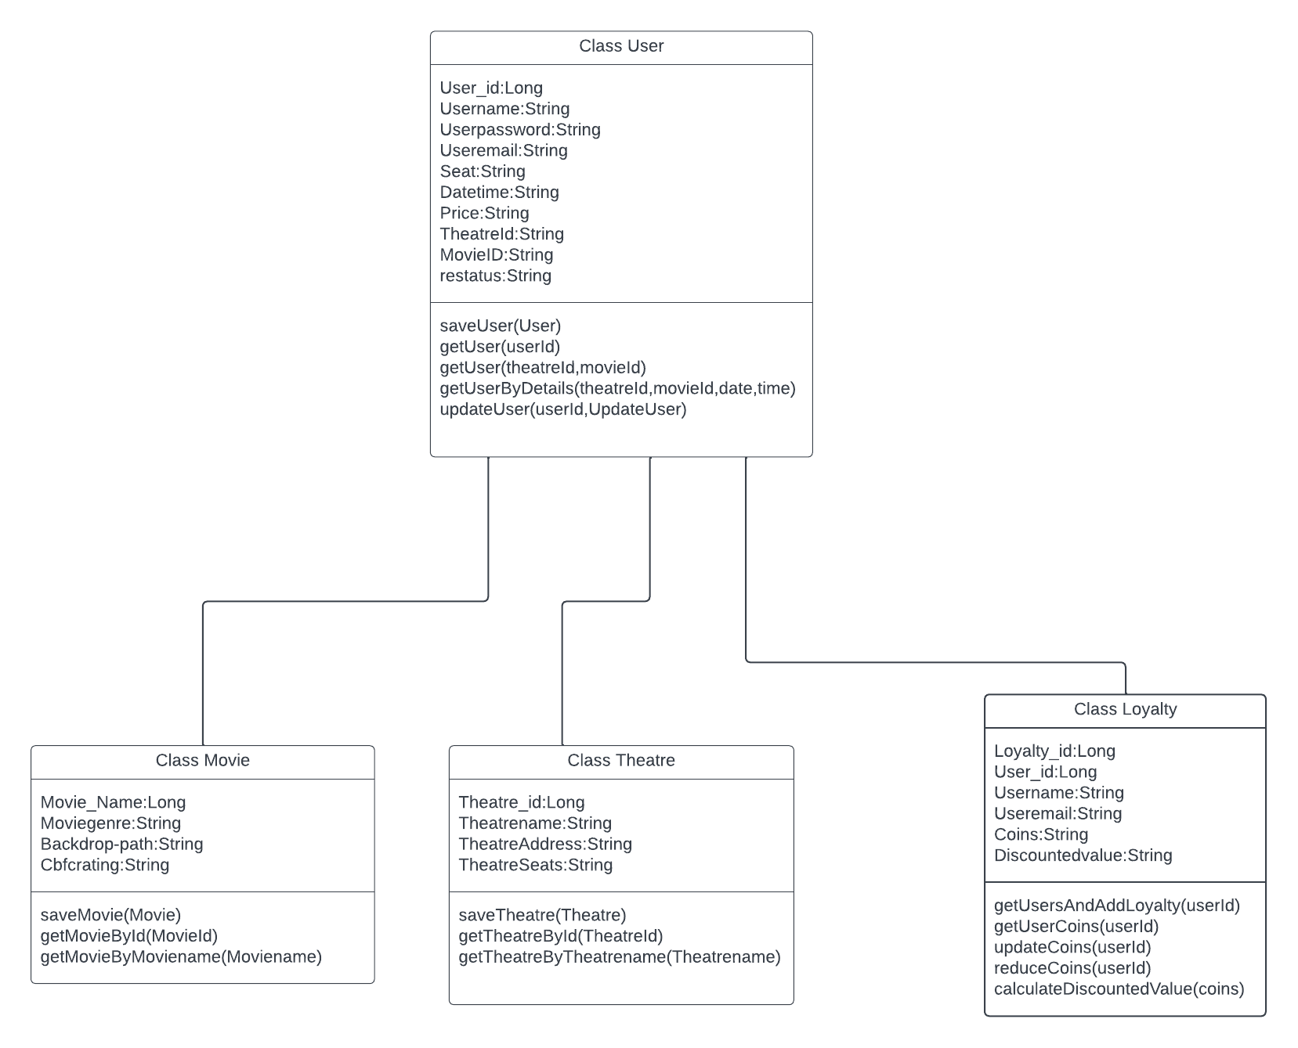
Class Diagram

Slide 9
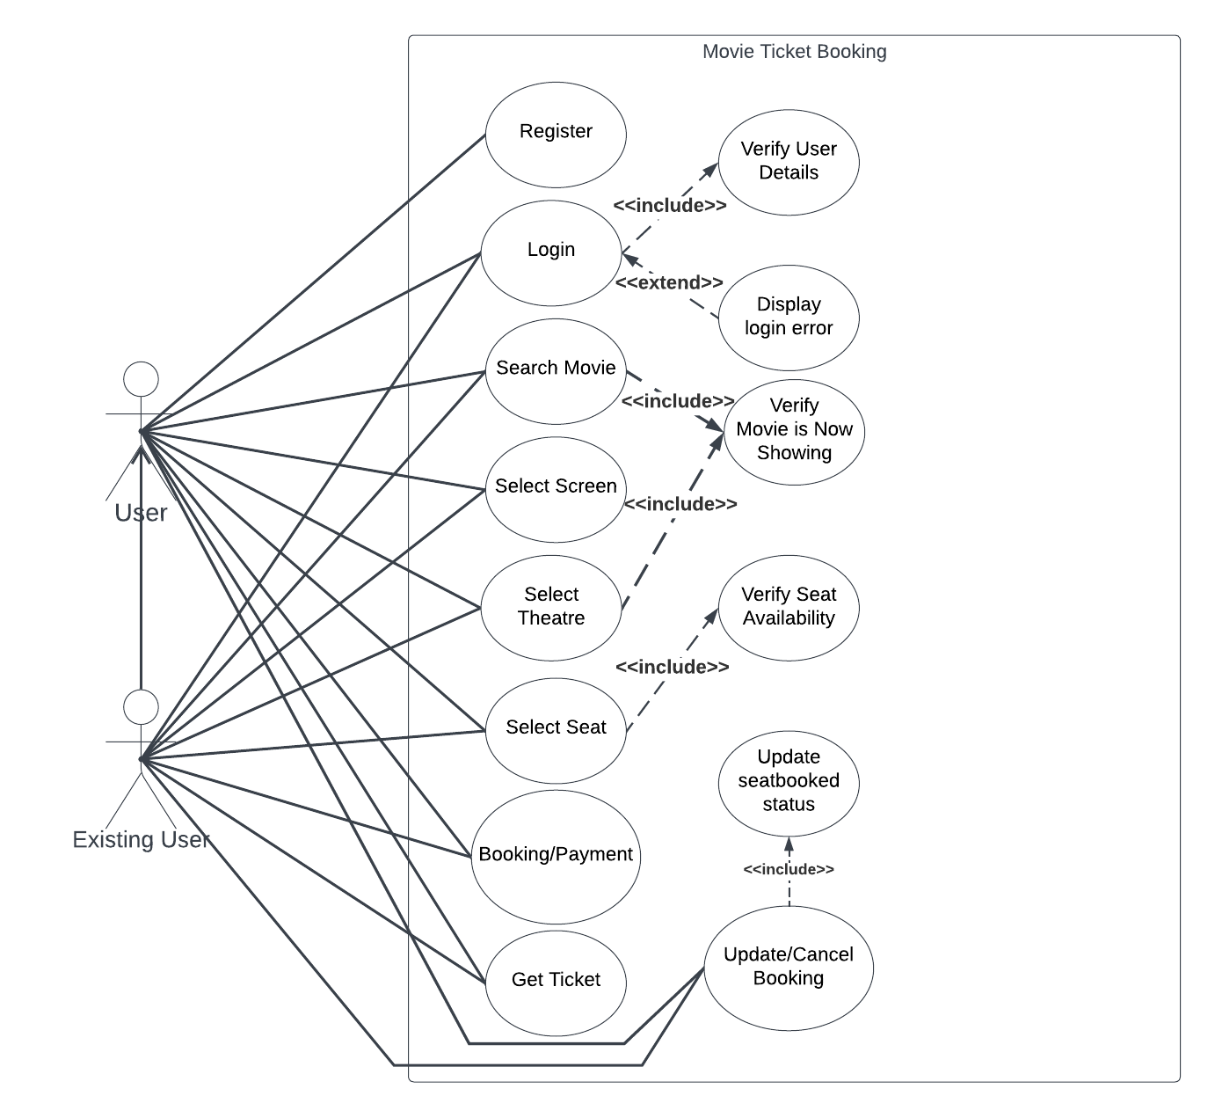
Use-Case Diagram

Slide 10
Twelve Factors
Some of the applicable twelve factors that have been taken into consideration include:

Slide 11
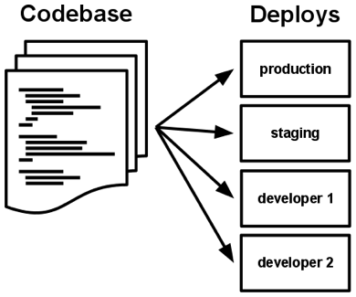
Code Base
The entire source code of the services and frontend code have been properly uploaded in github.
Any modification in the source code is regularly pushed to github as different versions.
A copy of this is available to all the developers.

Slide 12
Port Bindings
Each of the four microservices are made to run on isolated separate ports.
These ports make sure the REST API Endpoint do not overlap and each service processes its request only.

Slide 13
Concurrency
Concurrencyhas been achieved using “LockModeType.PESSIMISTIC_WRITE” type of lock to lock the database while the transaction is happening.
Here we use an instance of ReentrantLock() which returns a Lock object lock which is used with the tryLock() method.
Using lock.tryLock() function we make sure that if there are multiple threads executing concurrently ,and one thread has already acquired the lock the remaining thread requests return an Internal Server Error exception.

Slide 14
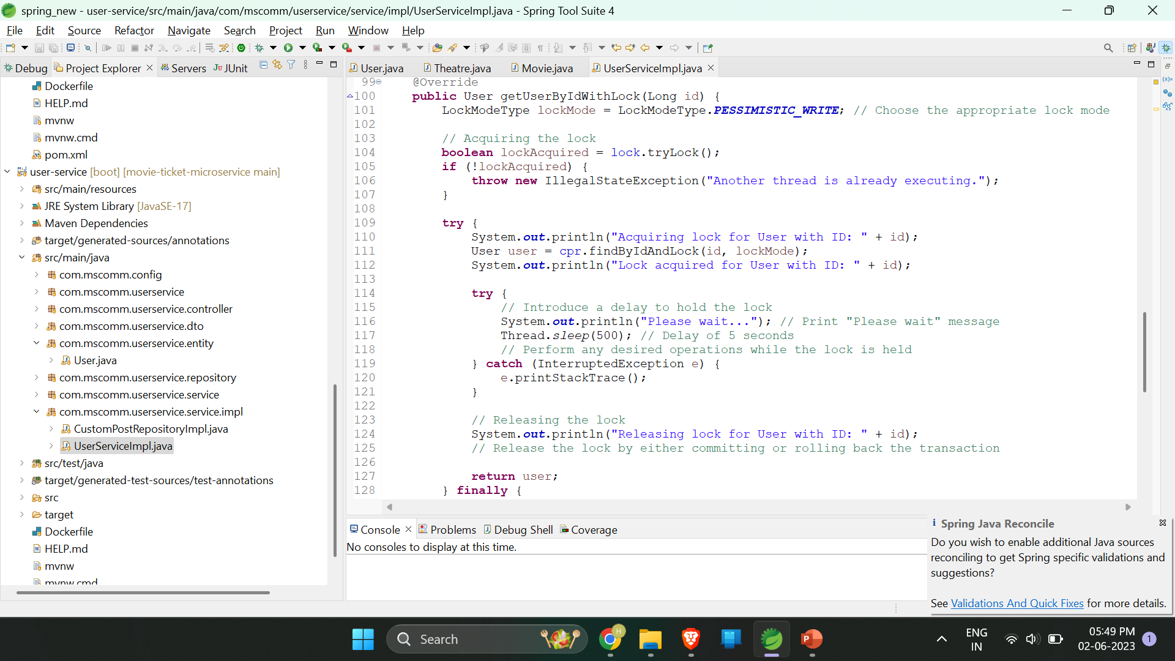
Concurrent Booking Code Segment(Service)

Slide 15
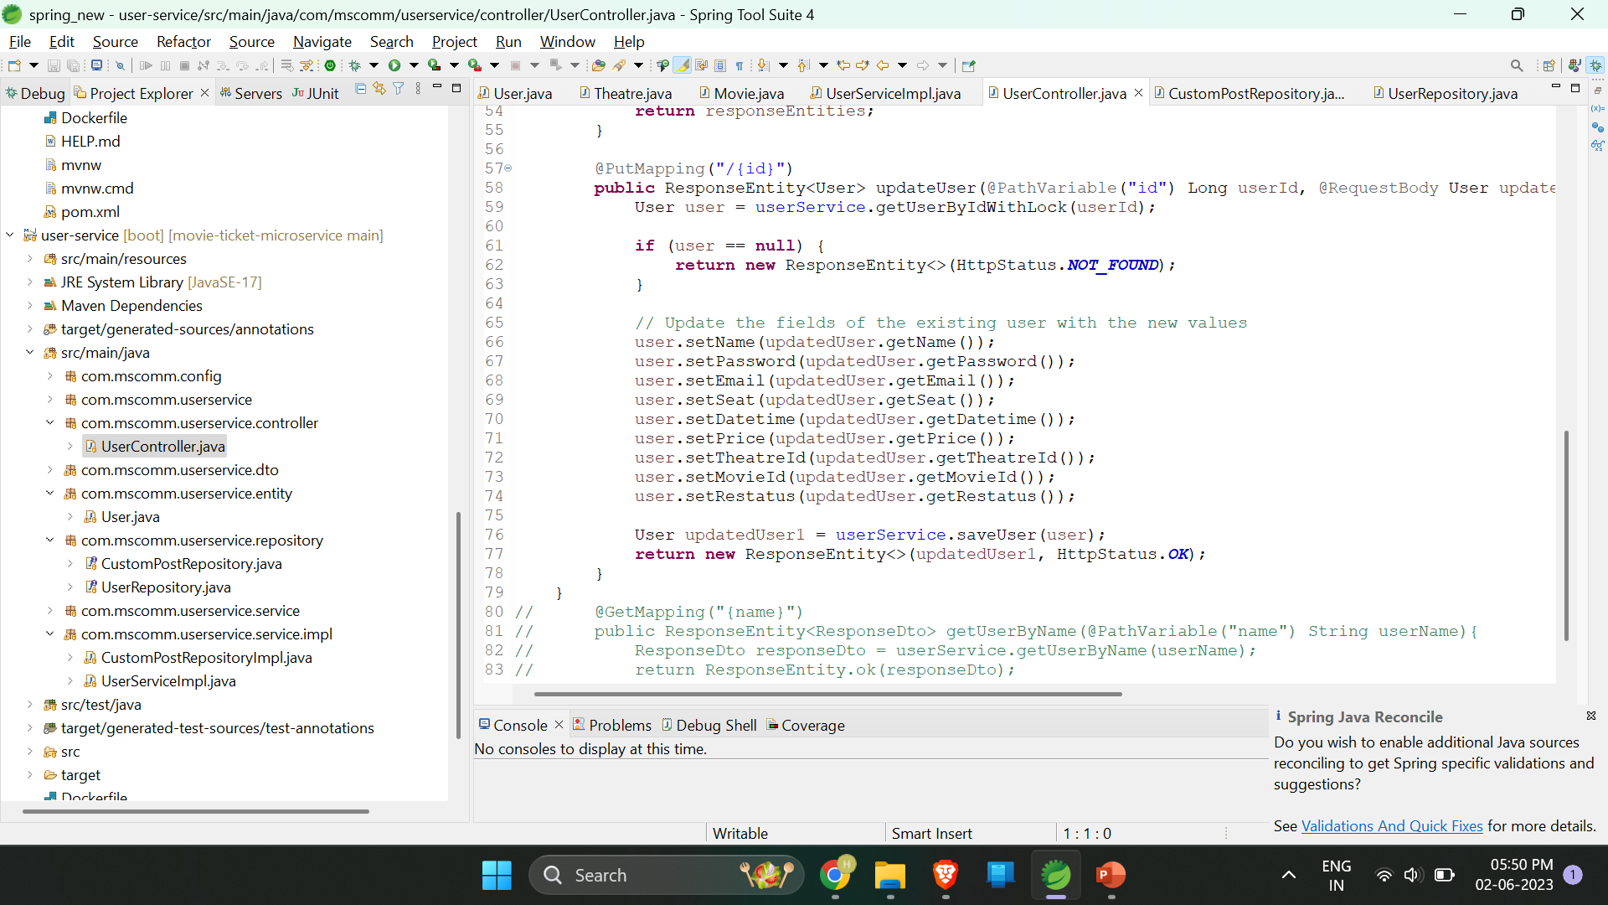
Concurrent Booking Code Segment(Controller)

Slide 16
Disposability
Each microservice can be individually stopped,built,modified,tested and can be re-run when needed.
These microservices can be swapped in for another microservice which might need to do a different job, with ease.

Slide 17
Challenges Faced

Slide 18
Some challenges faced
Implementing Concurrency:
We tried using synchronise() method for locking the resource but when tested with more than one threads/requests ,one thread locks the resource whereas the other threads do not return an exception but instead waits in order for the thread to gain access to the database.
This was not desired because if multiple users simultaneously presses the submit button for booking a movie at the same time with the same seat selection, only one should be given access to modify the database and not the other as by the time the second user also tries to modify the database the data would have been changed already.

Slide 19
Some challenges faced(contd..)
Hence we turned to the concept of ReentrantLock() as they offered a built in method called tryLock() which can be used to store a Boolean value true if a thread is consuming a resource and if false throws out an Internal Server Error exception.
Age Verification:
We thought of implementing a system where age verification could be granted by designated people accepting the proof submitted by users but that would be tedious task,just making users enter their age in a input box and verifying also would not suffice as anyone could enter any age and get through booking.
Then we thought of a OCR(Optical Character Recognition) idea which can be implemented through an online API which can be modified to extract the user’s Date Of Birth and doesn’t store any data in its online server.So we chose this idea over any other implementation of age verification.

Slide 20
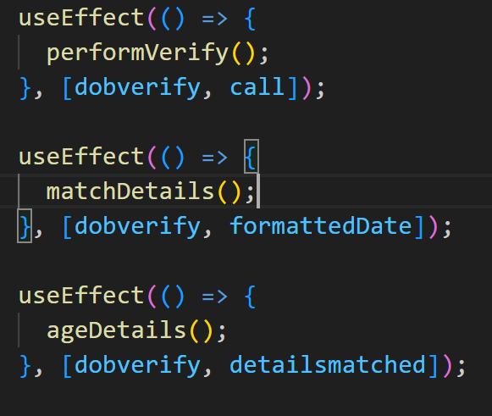
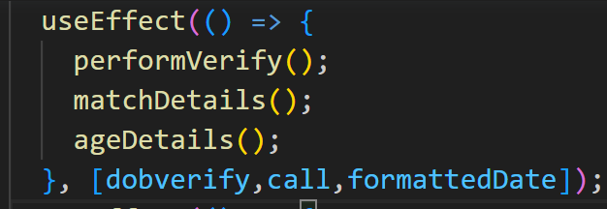

Some challenges faced(contd..)
Asynchronous nature of useEffect():
Transformed to

Slide 21
Test Cases
User-service
Movie-service
Theatre-service
Loyalty-service

Slide 22
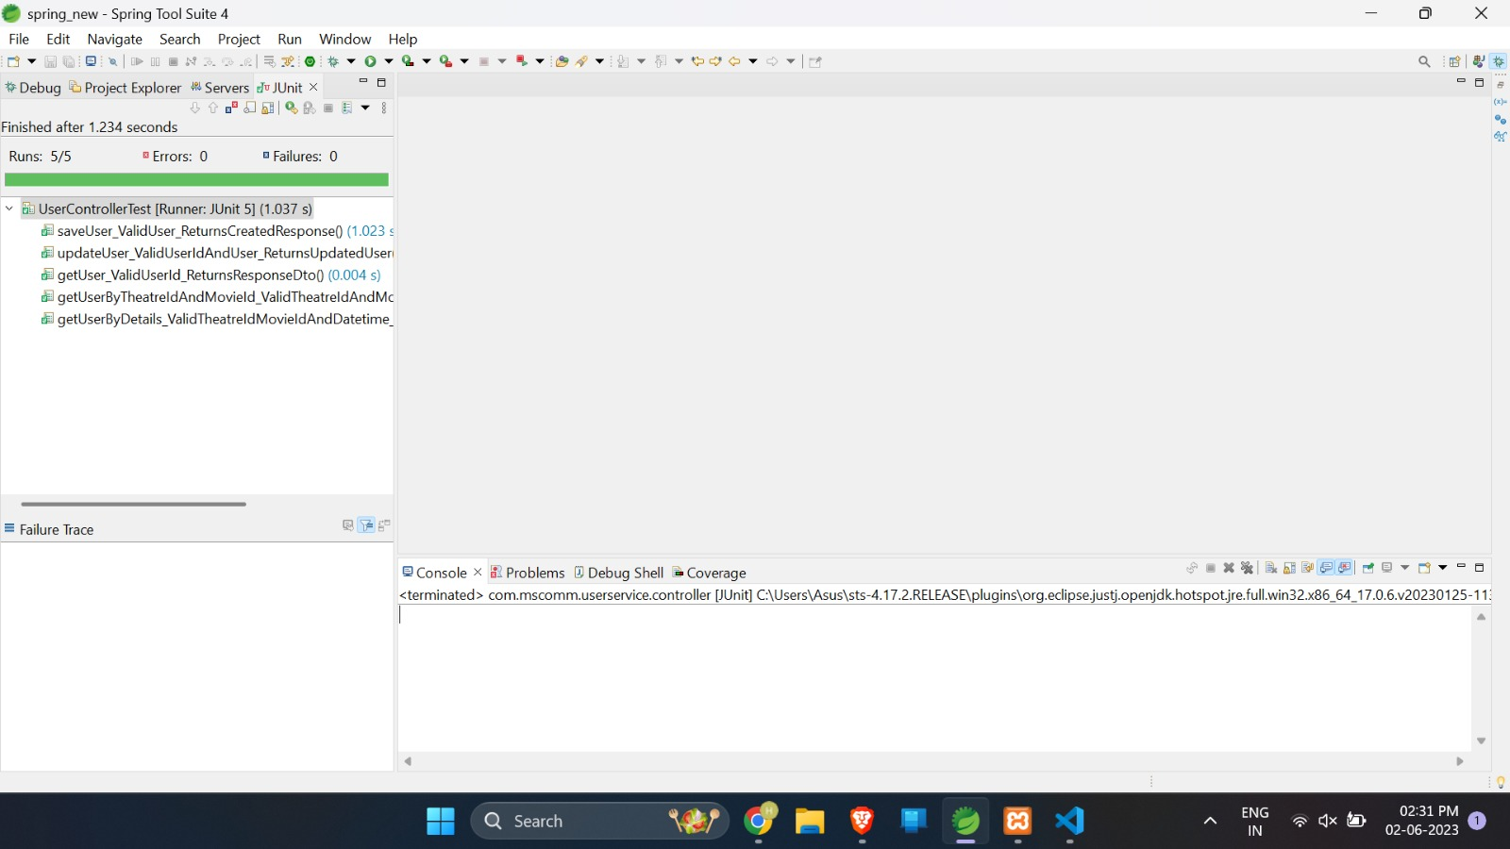
User-service controller test

Slide 23
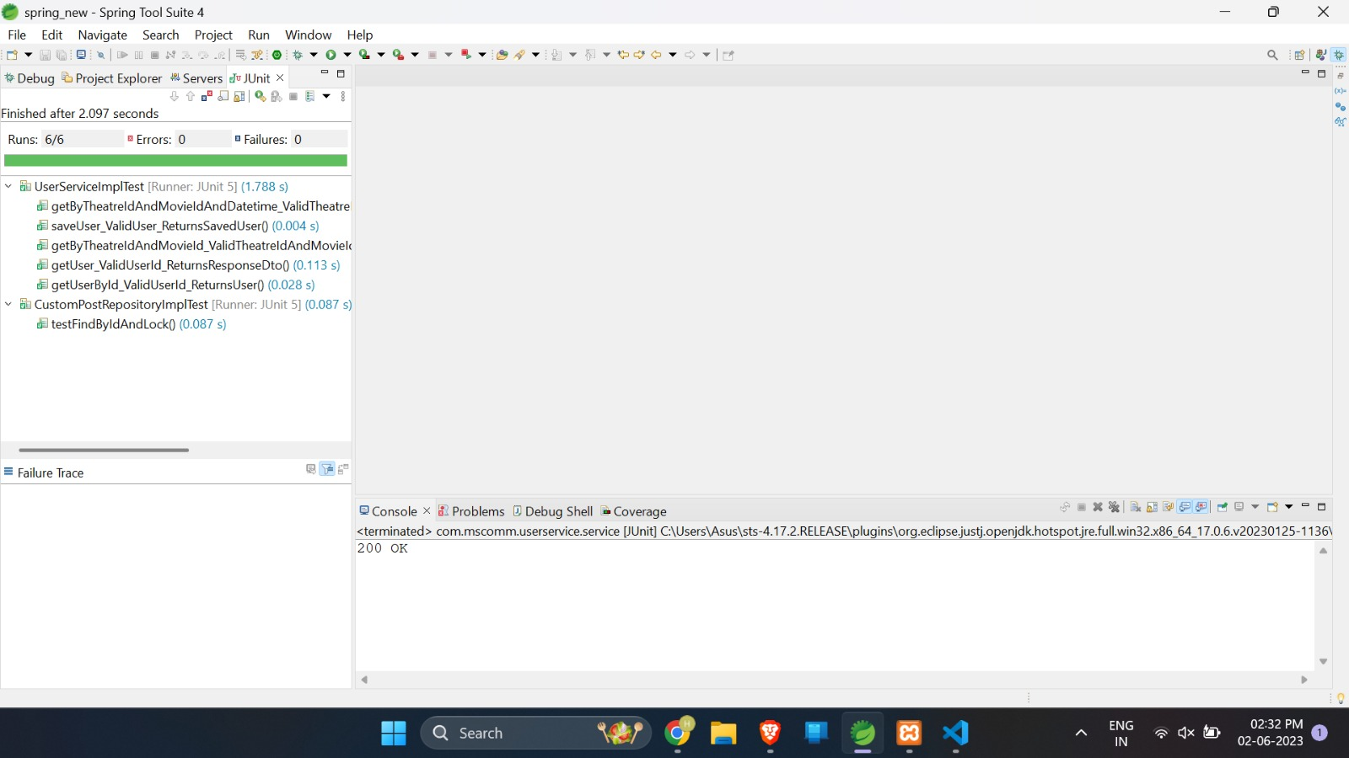
User-service service test

Slide 24
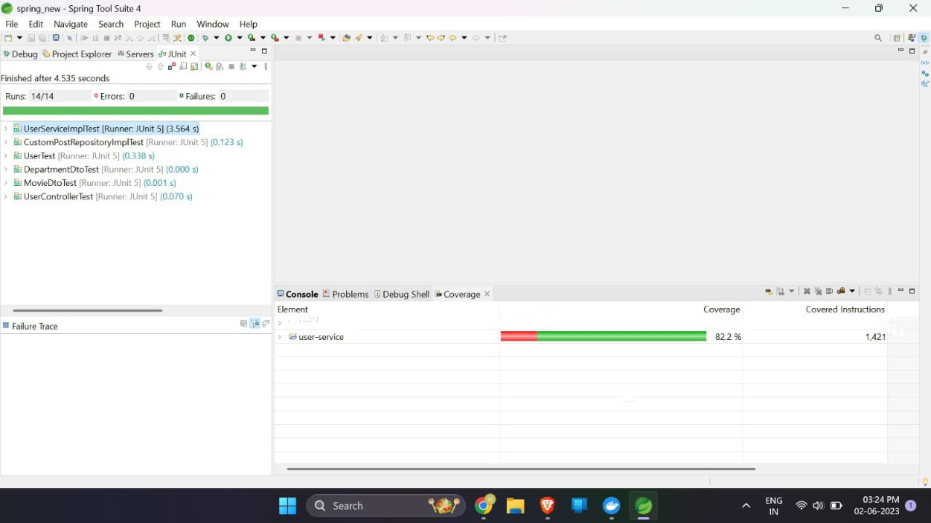
User-service code coverage

Slide 25
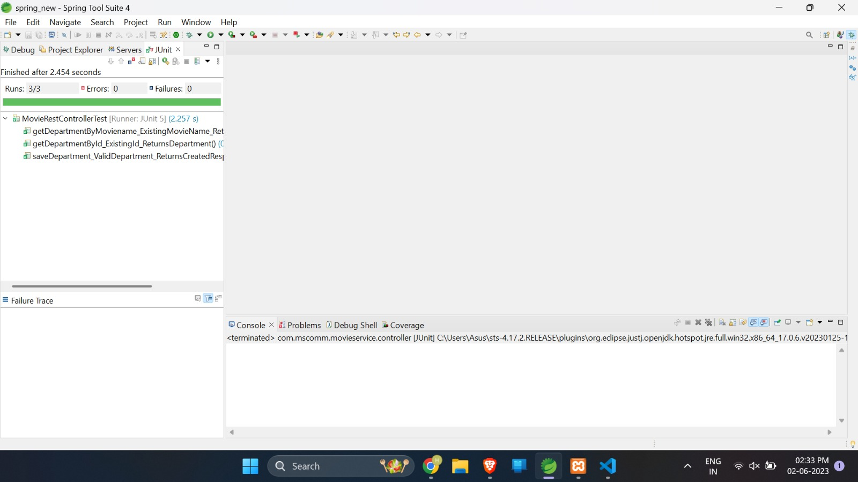
Movie-service controller test

Slide 26
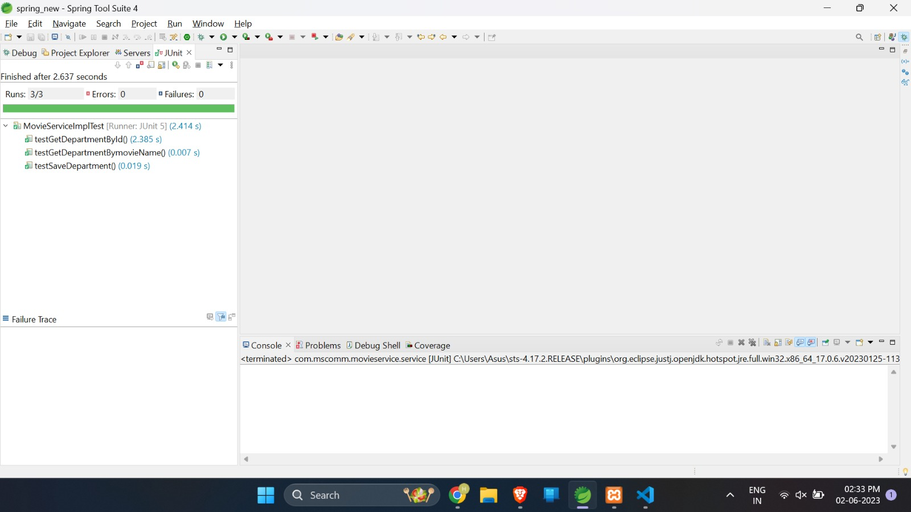
Movie-service service test

Slide 27
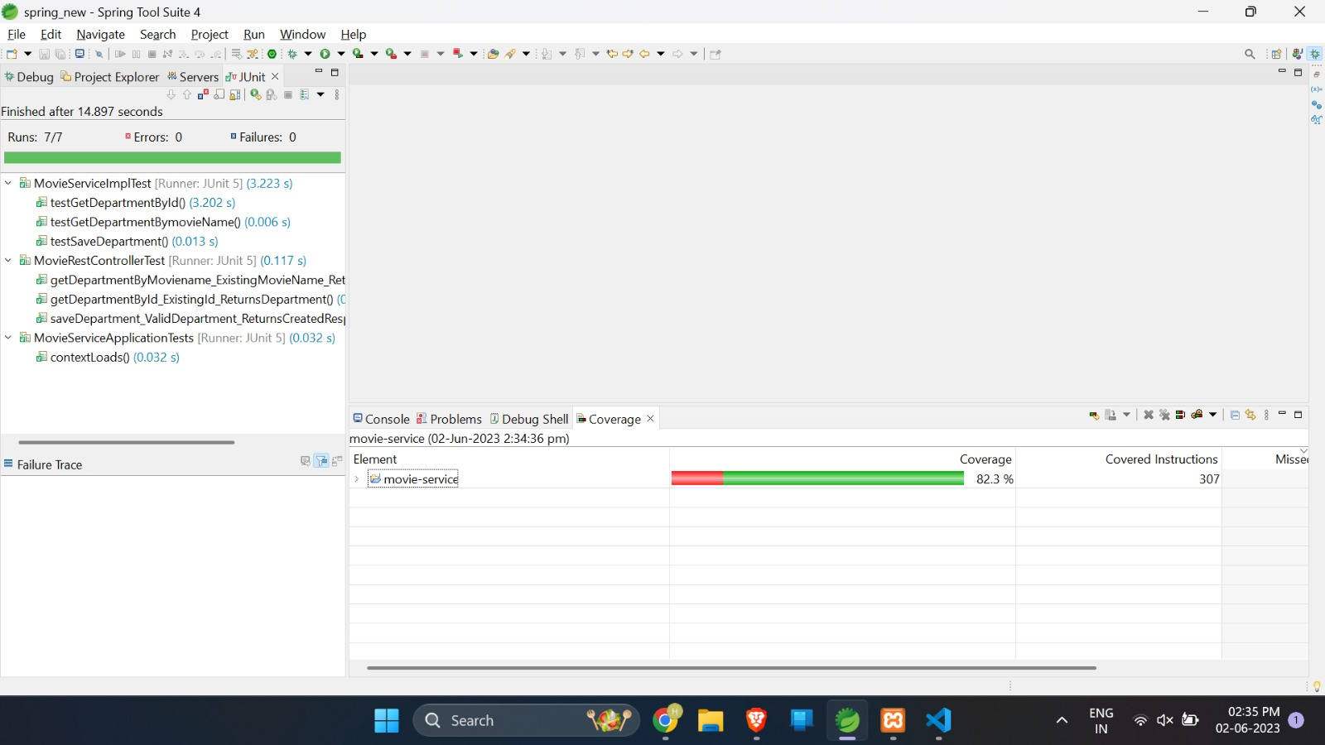
Movie-service code coverage

Slide 28
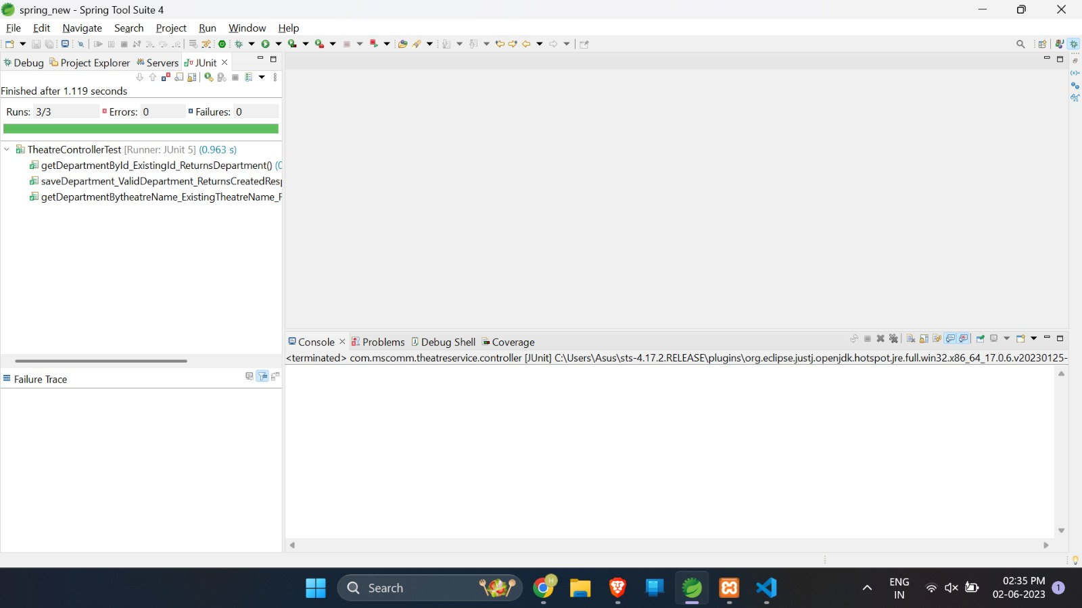
Theatre-service controller test

Slide 29

Theatre-service service test

Slide 30
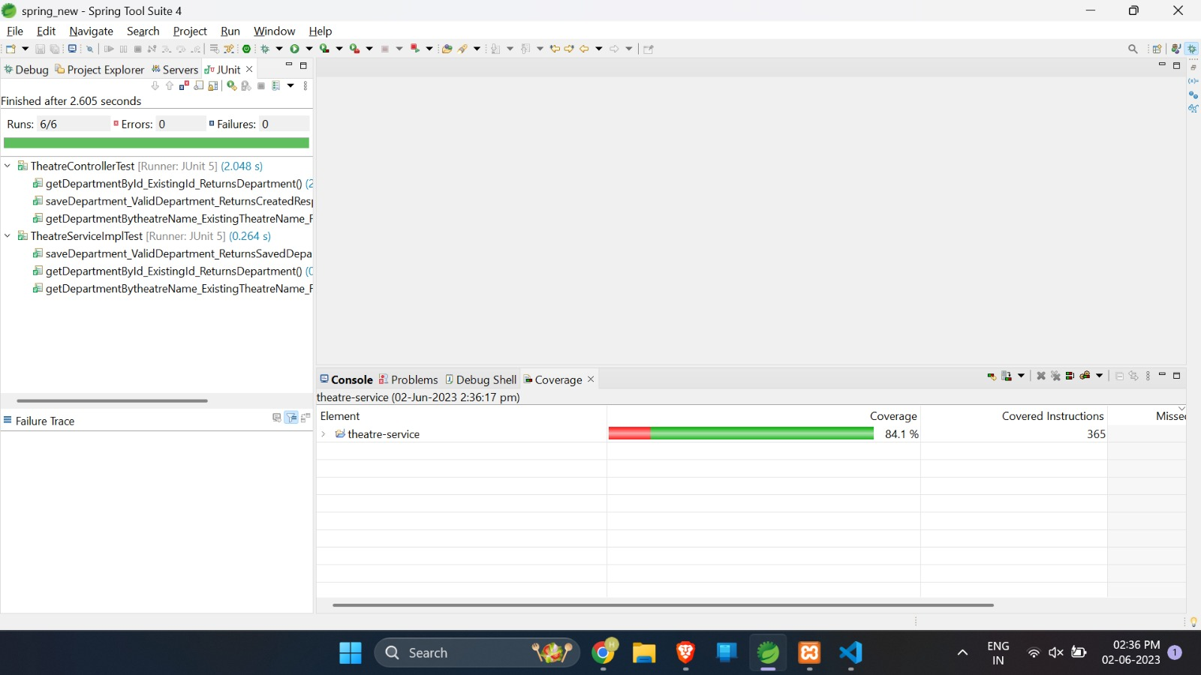
Theatre-service code coverage

Slide 31
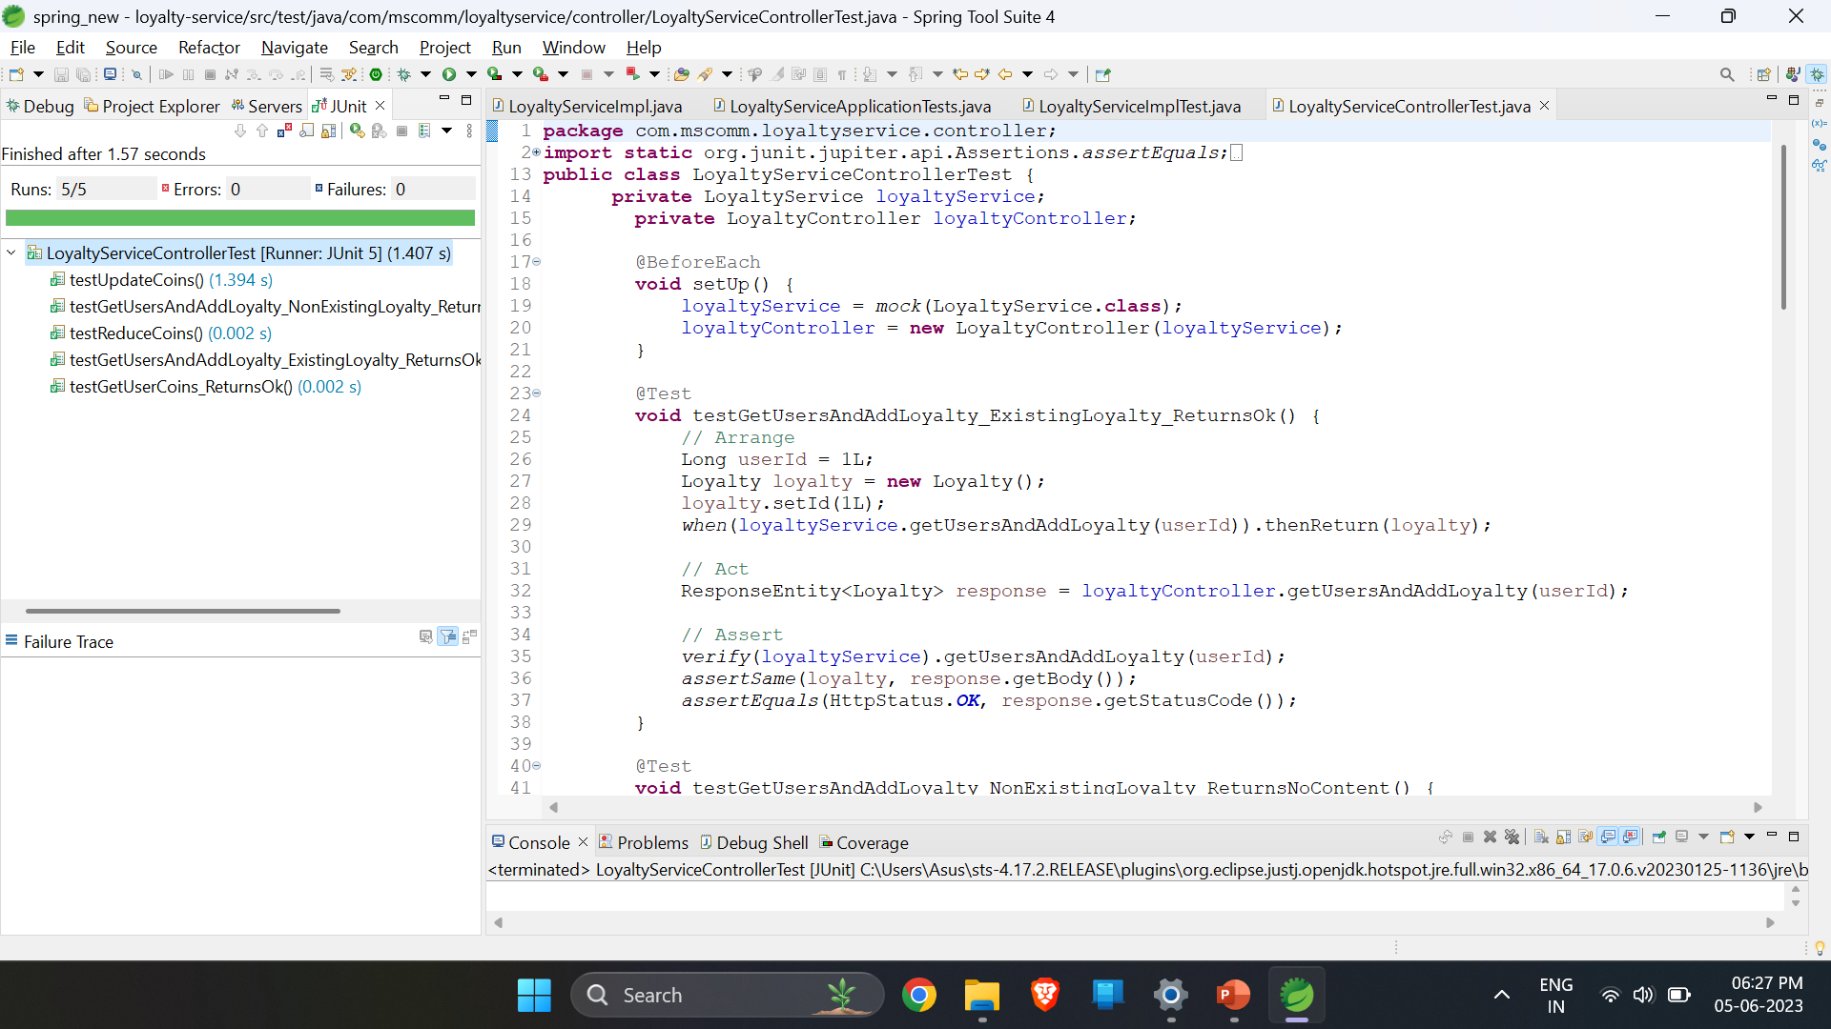
Loyalty-service controller test

Slide 32
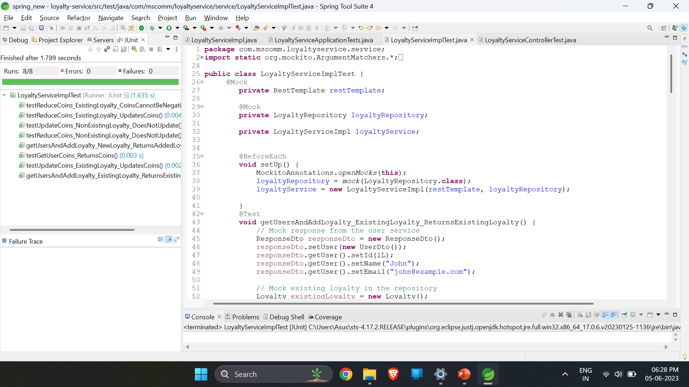
Loyalty-service service test

Slide 33
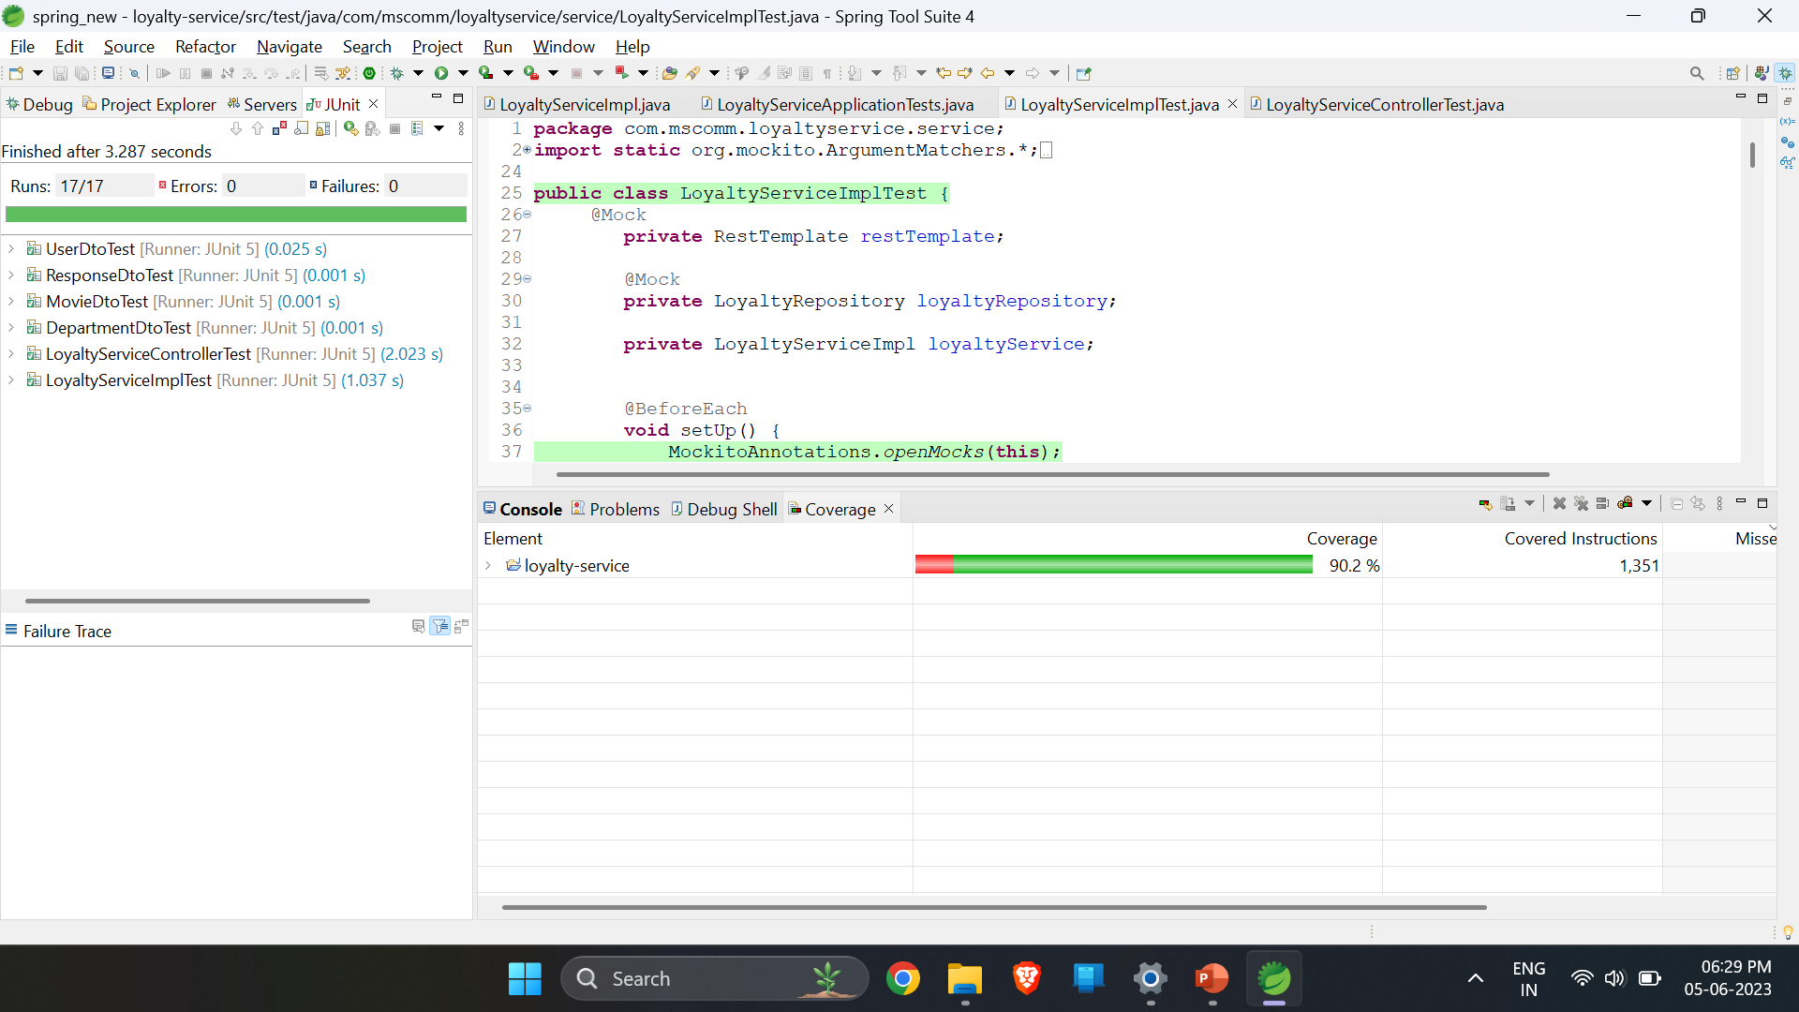
Loyalty-service code coverage

Slide 34
Website Pictures
Cineone

Slide 35
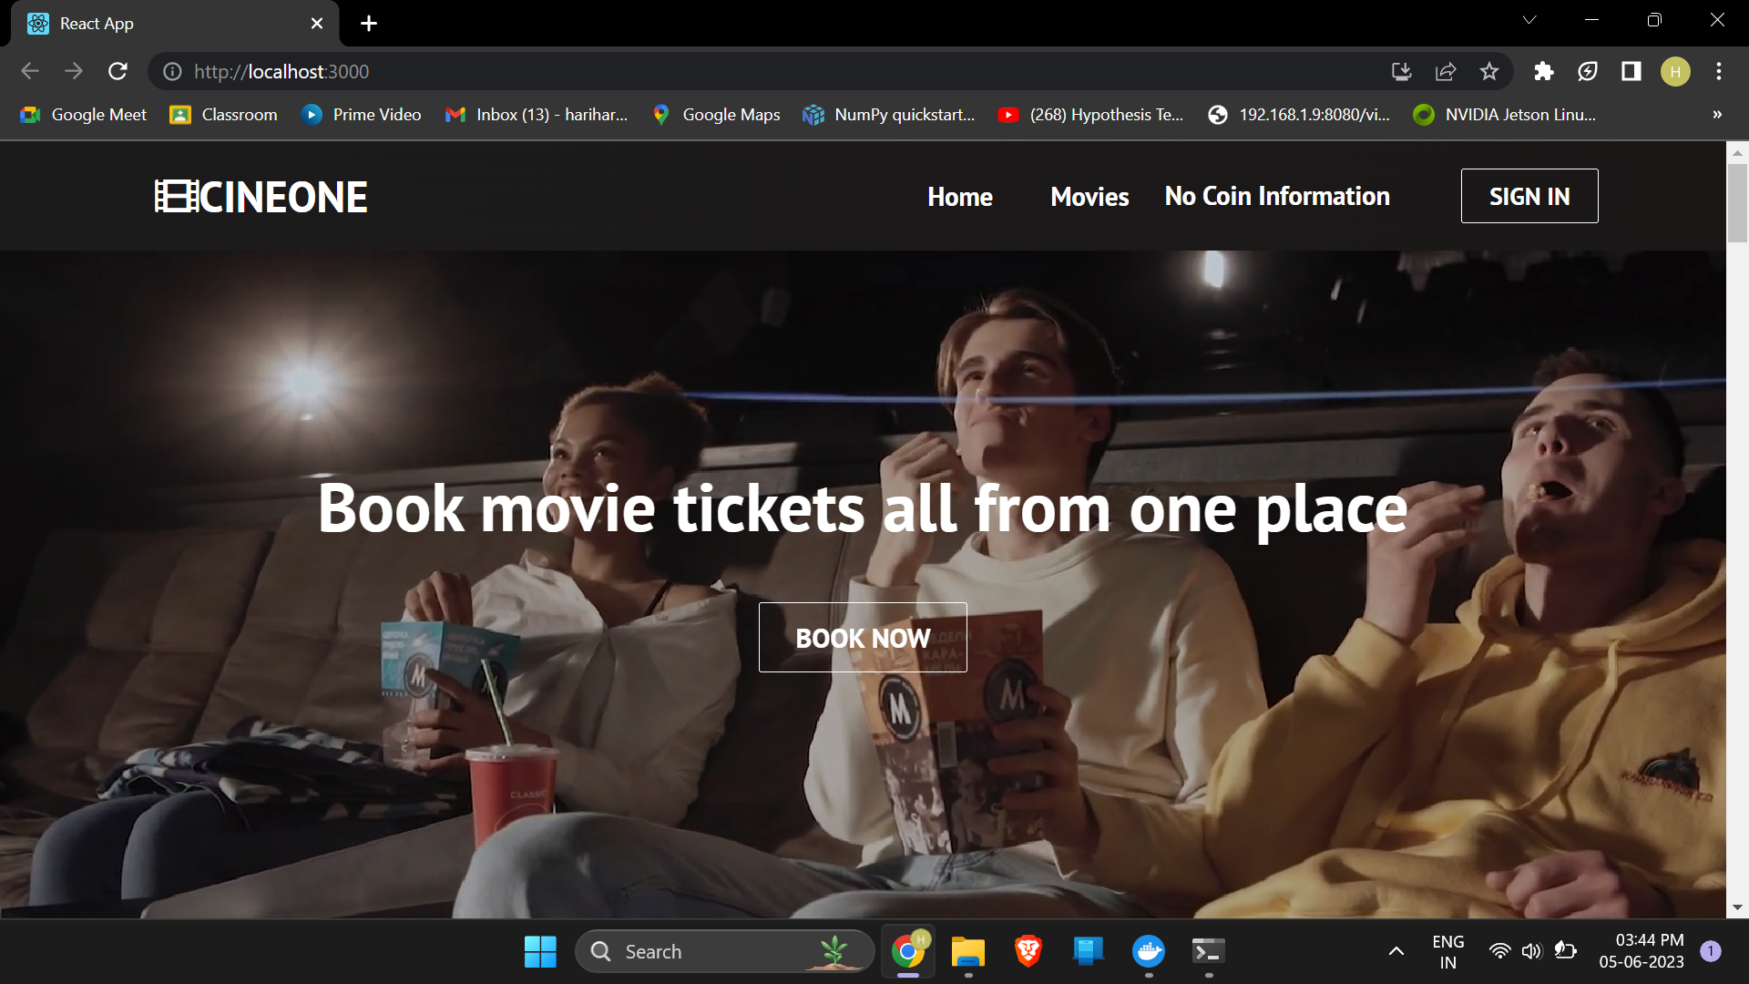
Website Pictures

Slide 36
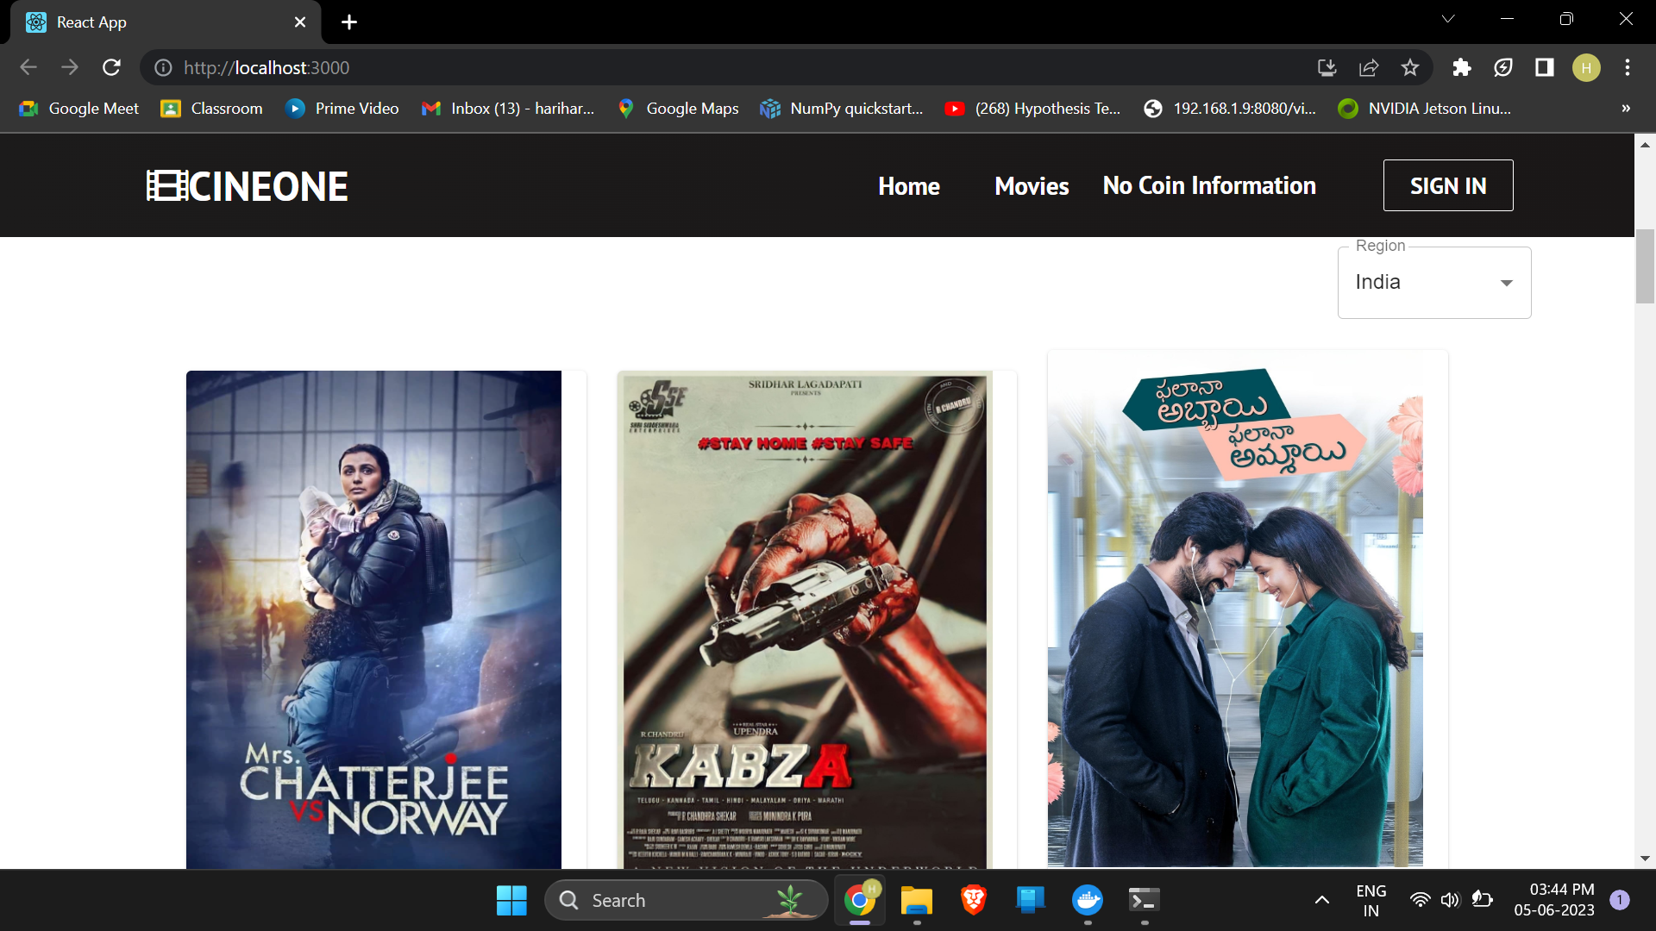
Website Pictures

Slide 37
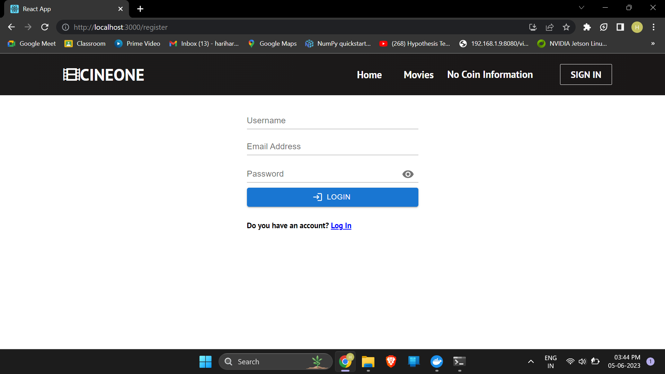
Website Pictures (Signup)

Slide 38

Website Pictures (Movies)

Slide 39
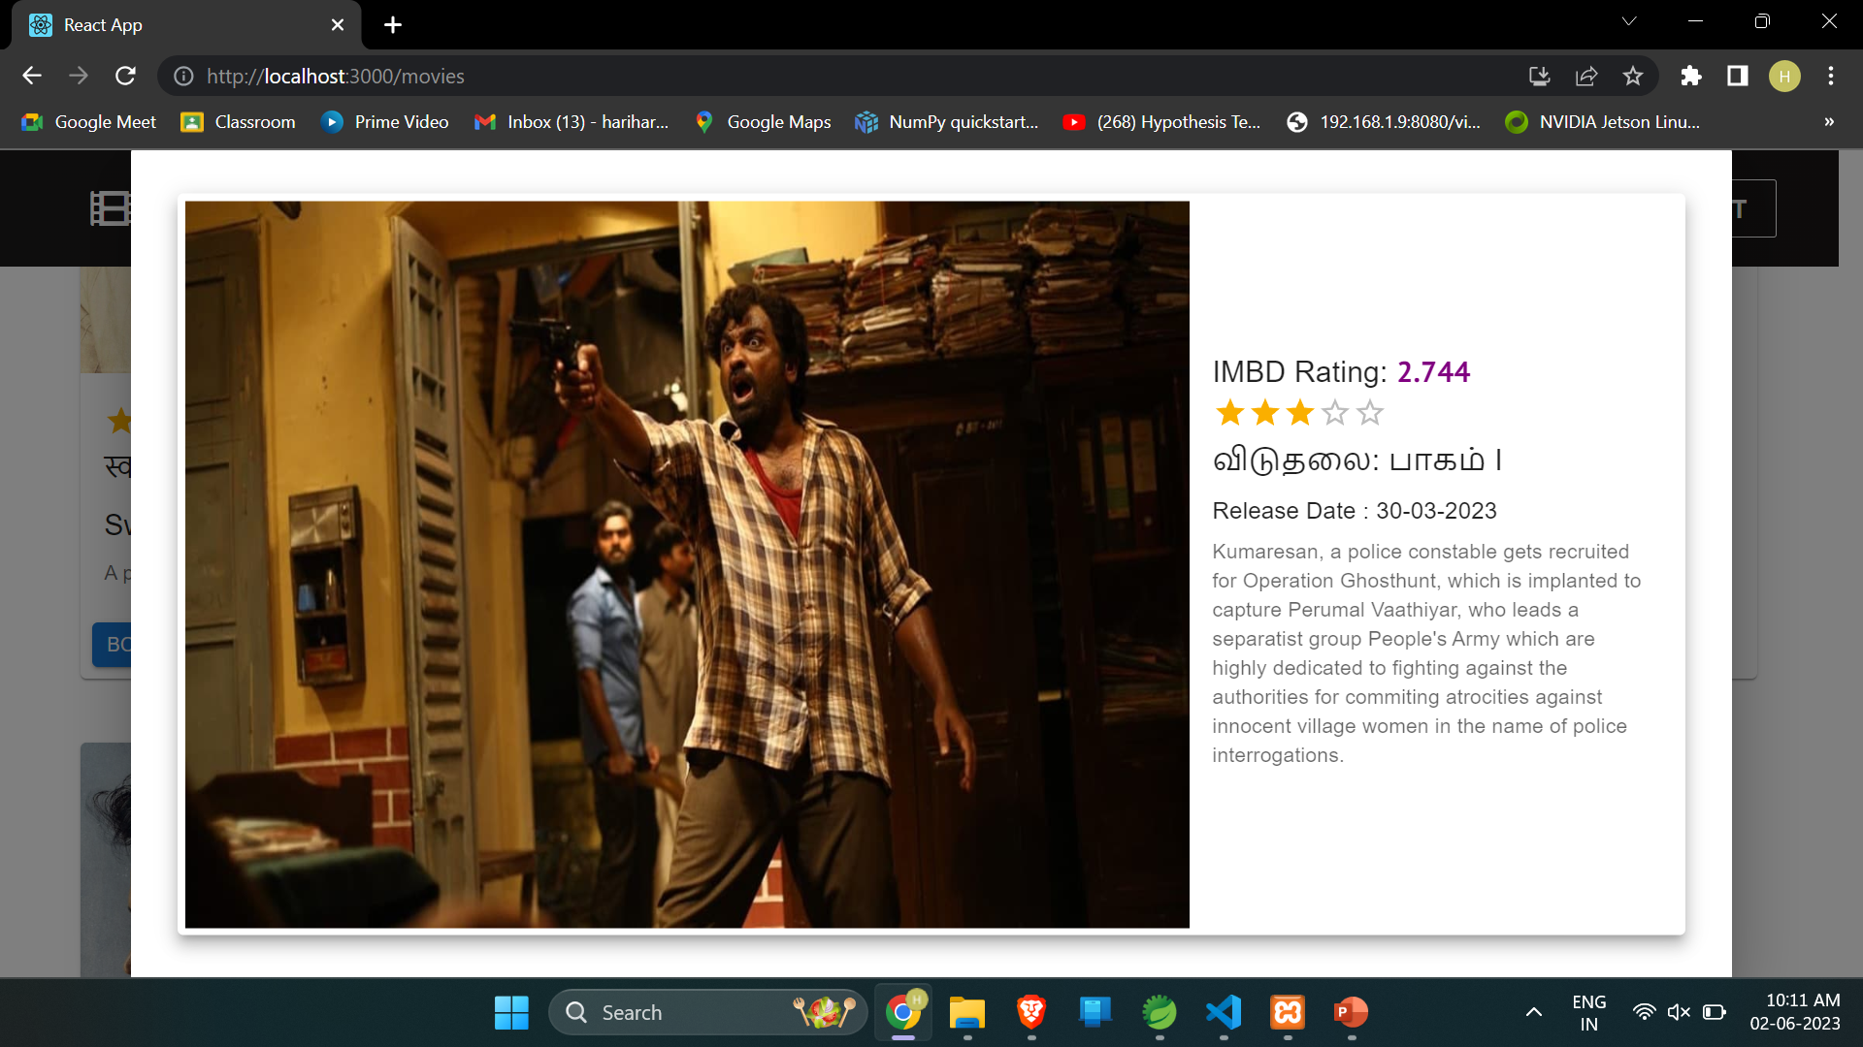
Website Pictures (Movie More Details)

Slide 40
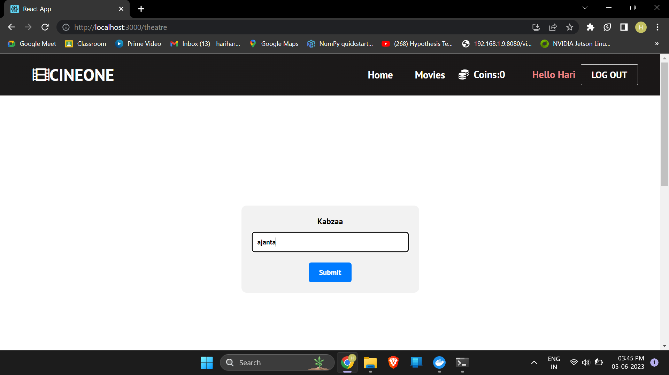
Website Pictures (Select Theatre)

Slide 41
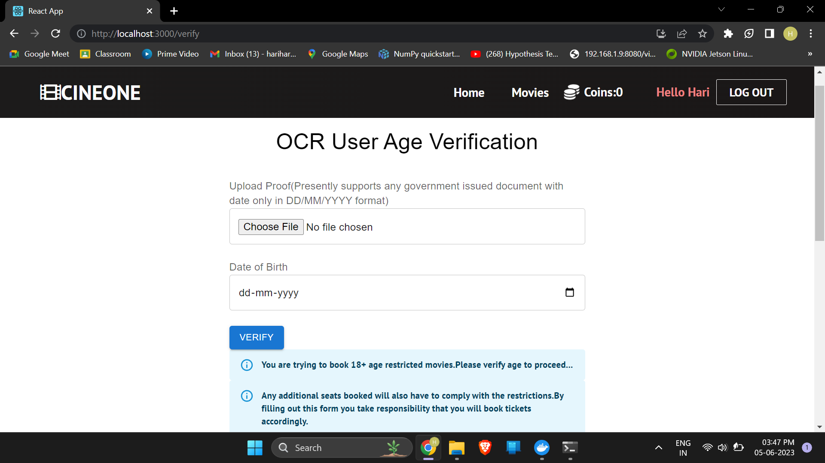
Website Pictures (Age Verification for A Movies)

Slide 42
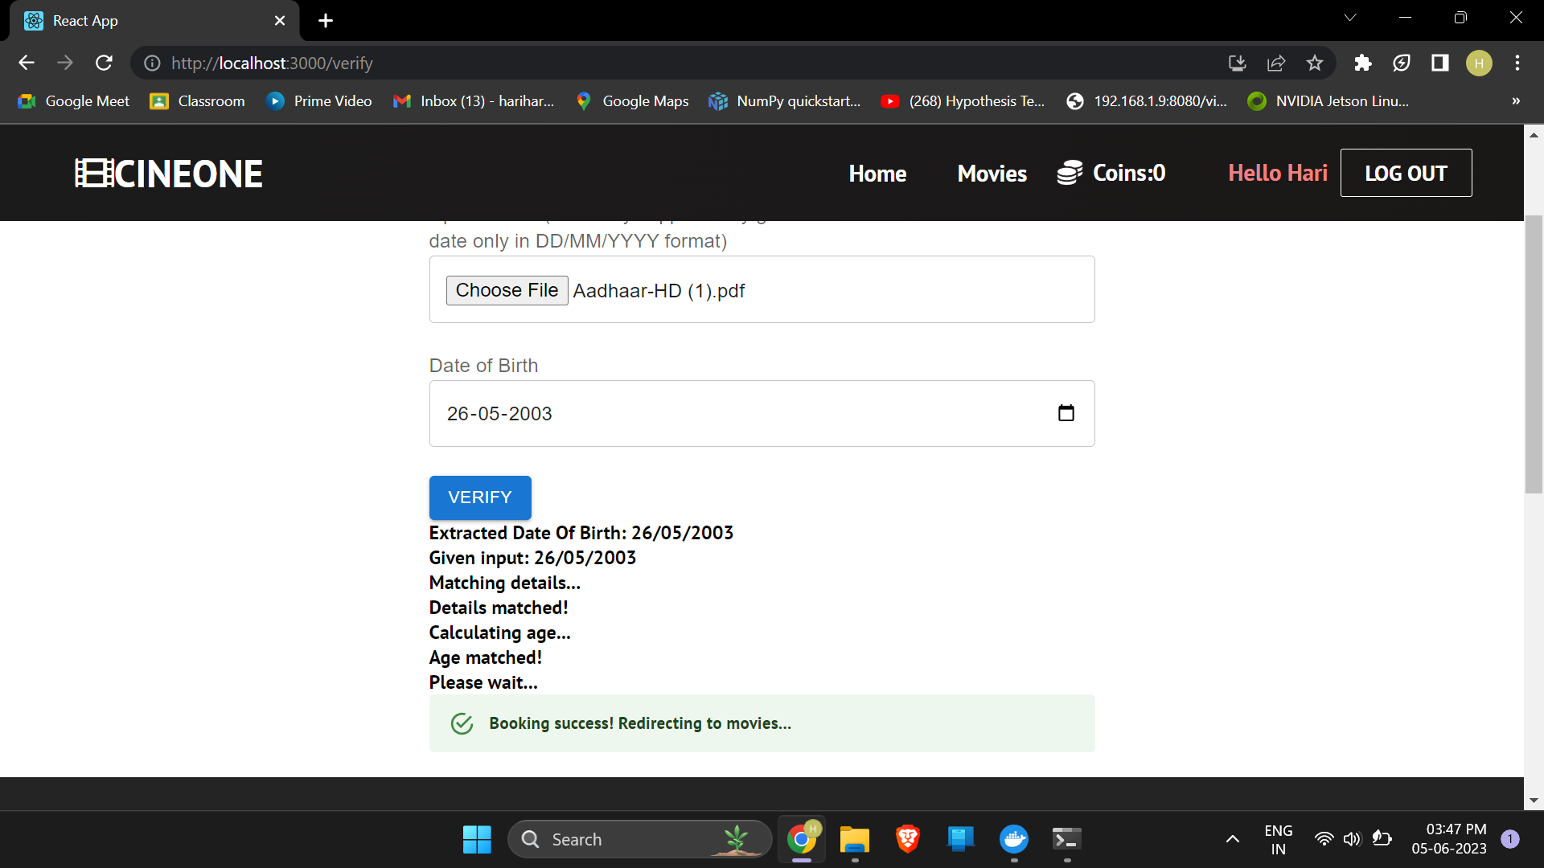
Website Pictures (Calculates age with extracted Date of Birth)

Slide 43
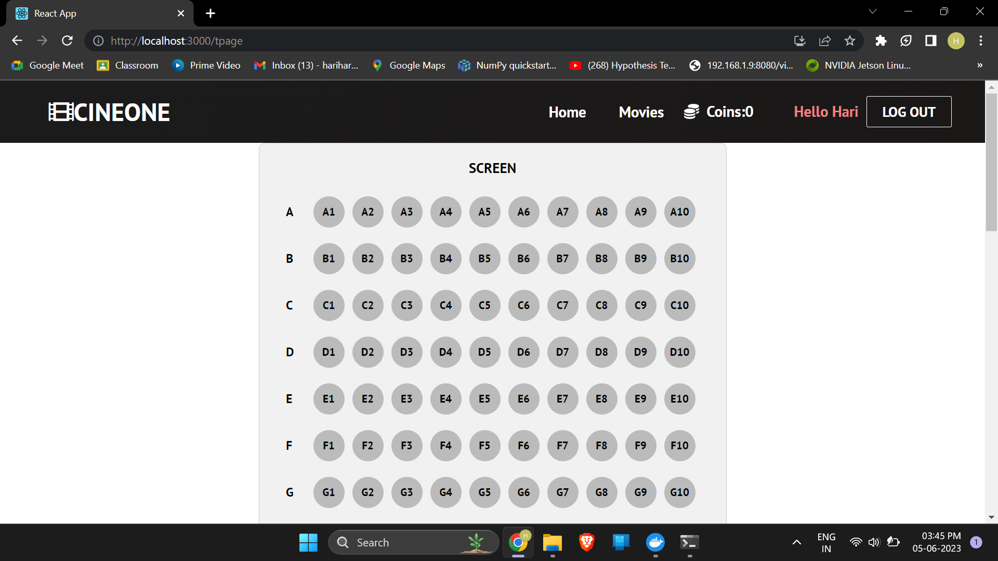
Website Pictures (Seat Details)

Slide 44
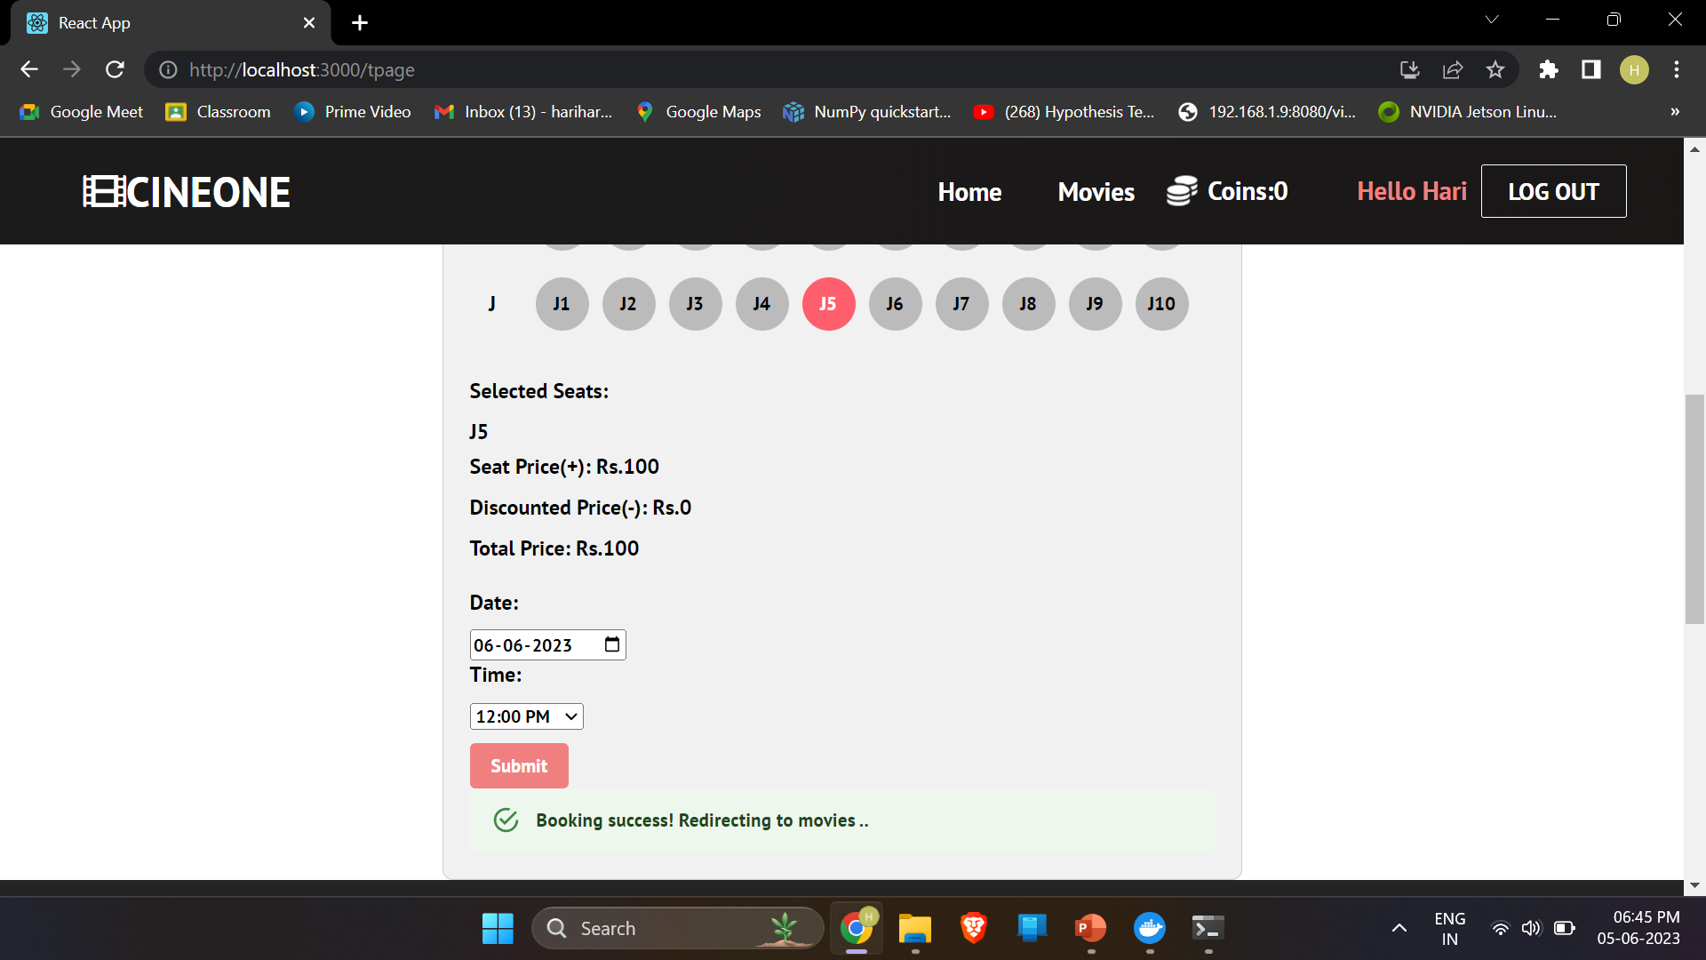
Website Pictures (Seat Details)

Slide 45
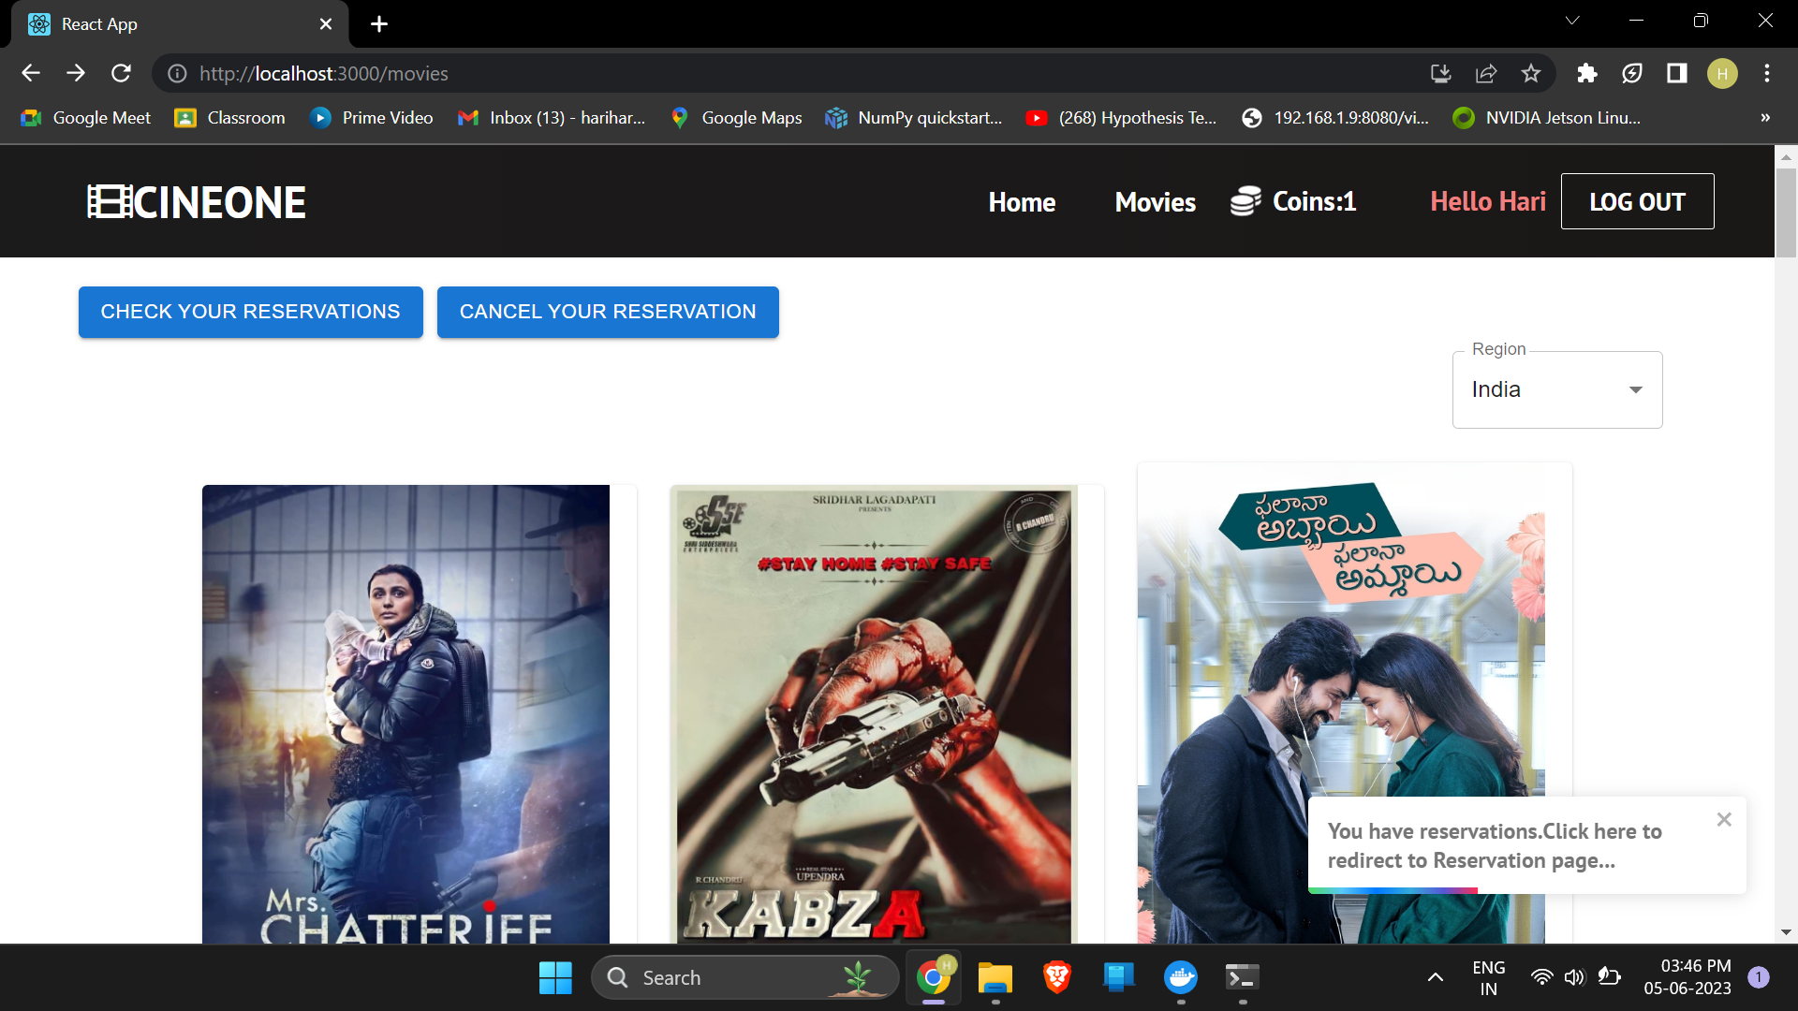
Website Pictures (Home page after reservation)

Slide 46
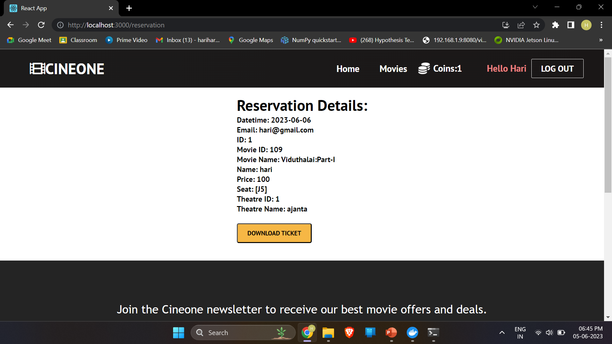
Website Pictures (Reservation Details)

Slide 47
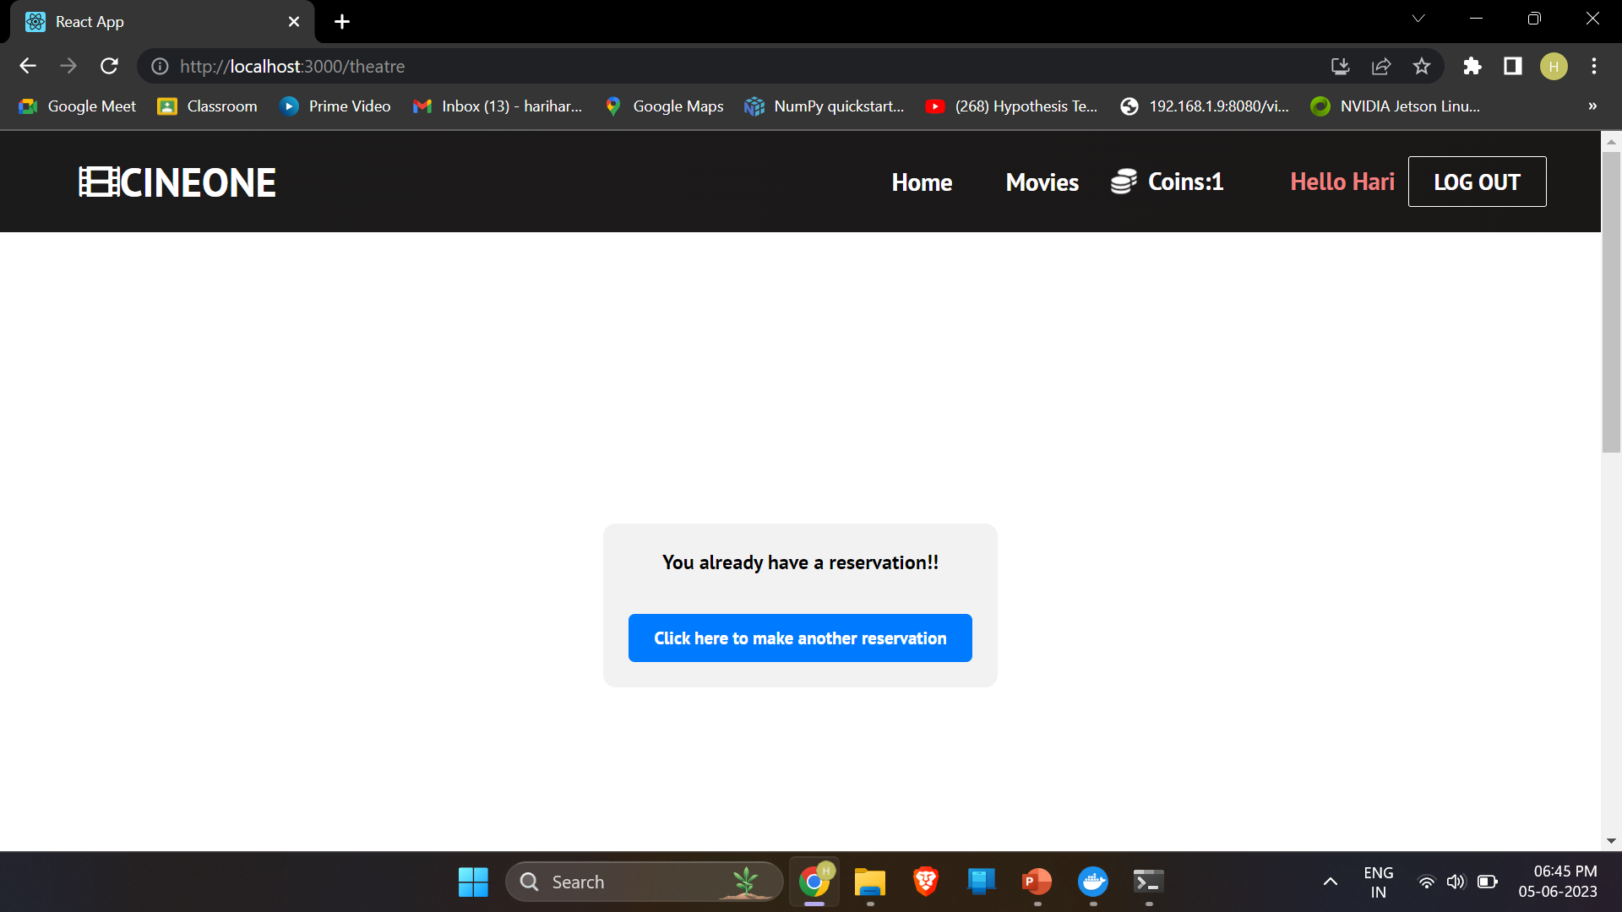
Website Pictures (User needs to sign in separately to book another ticket)

Slide 48
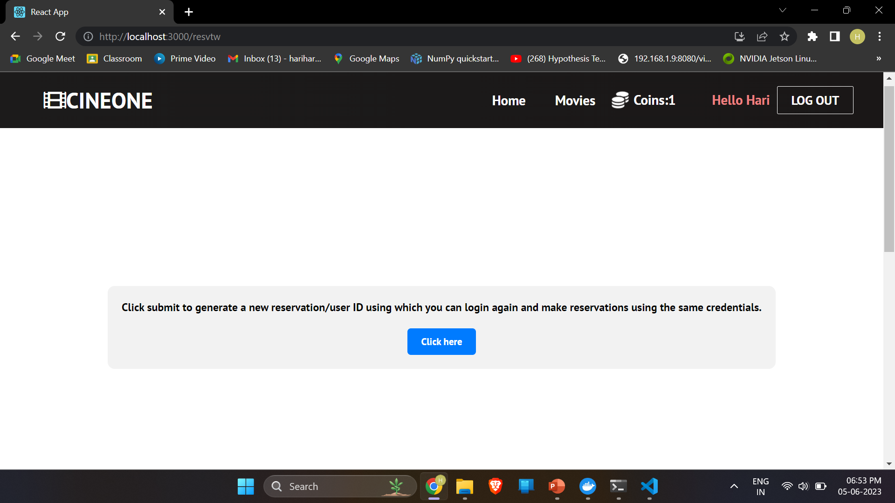
Website Pictures (User needs to sign in separately to book another ticket)

Slide 49
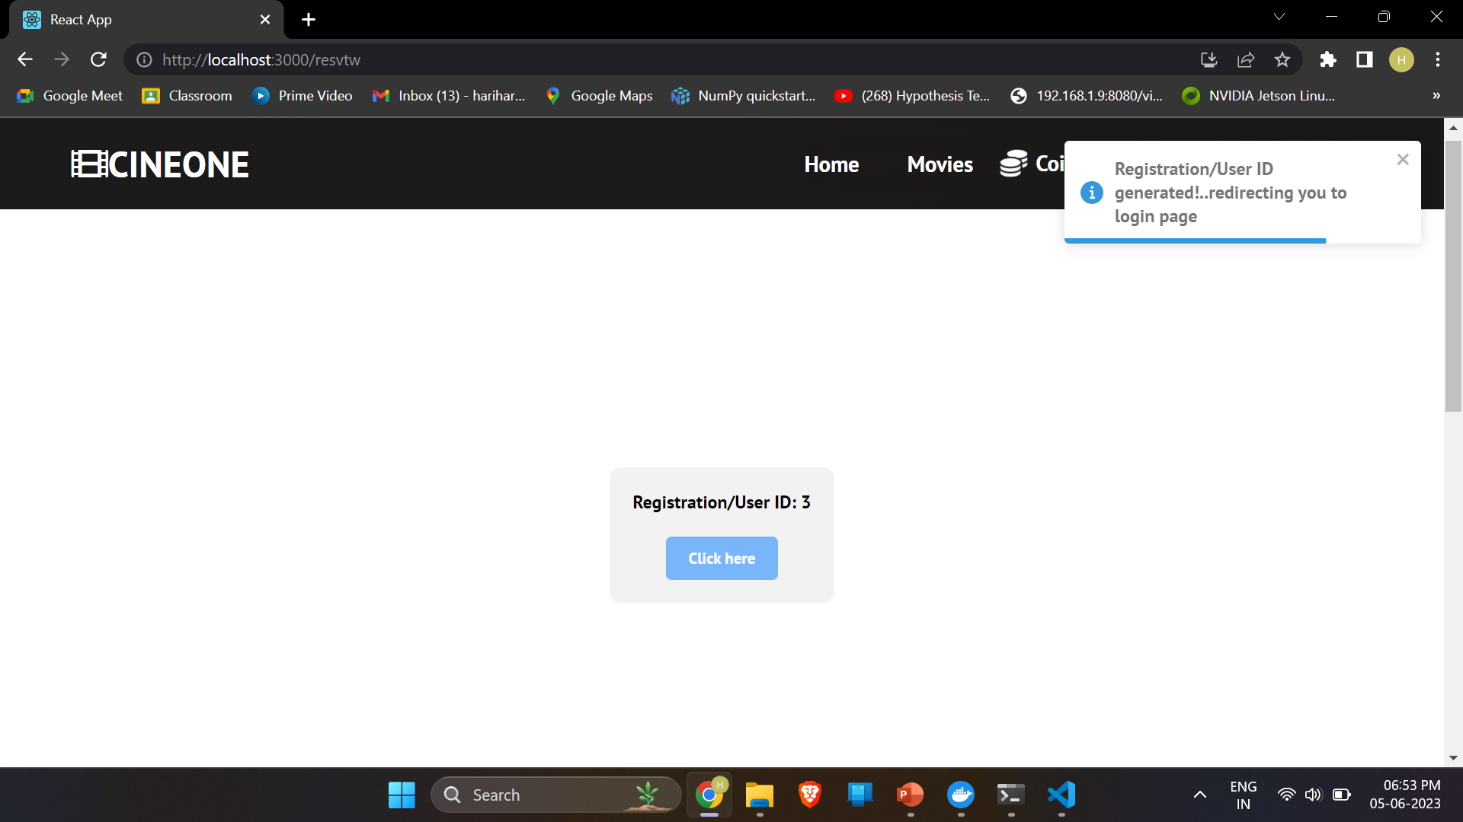
Website Pictures (User uses this ID to book another ticket)

Slide 50
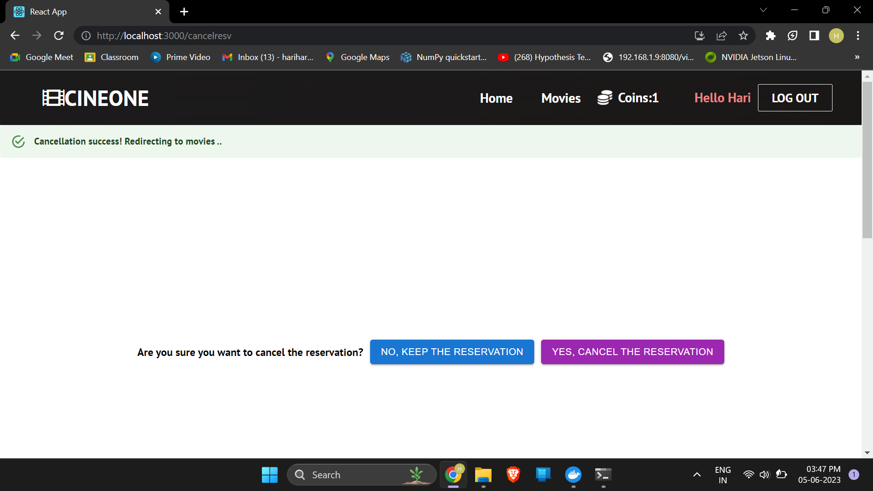
Website Pictures (Booking Cancellation)

Slide 51
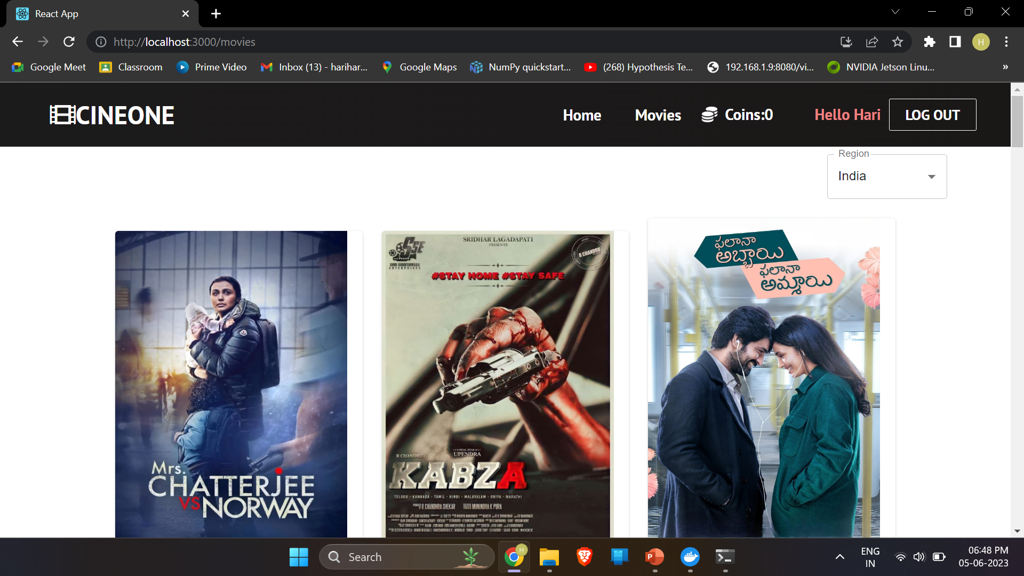
Website Pictures (Home page after cancellation)

Slide 52
Thank You !

